Slide 1





Part 7 – Serving LLM-based Web Applications
Quang Duong

Slide 2
What We Will Learn
Creating the Frontend and Backend as two separate services
Communicating between frontend and backend using a REST API
Serving the application with Docker
Install, run and enable communication between Frontend and Backend in a single Docker container
Use-case
An LLM-based song recommendation app

Slide 3

Serving LLM-based Web Applications
REST API
Backend
Python,
LangChain,
OpenAI API
FAISS
Frontend
Python
Gradio
Docker Desktop
Dockerfile
docker-compose

Slide 4
Software Prerequisites for Serving App
FastAPI
pip install fastapi==0.104.1

Slide 5
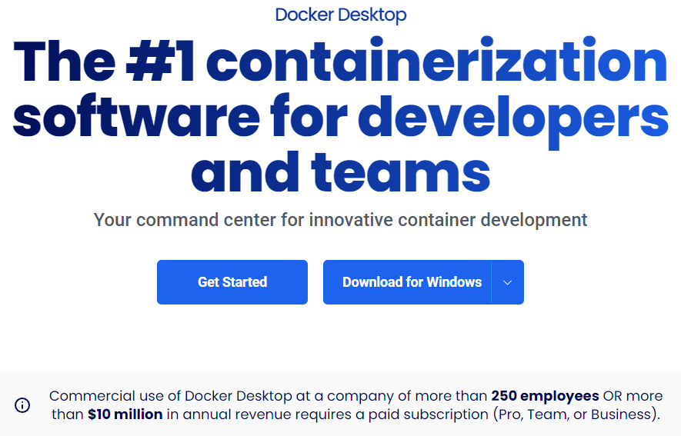
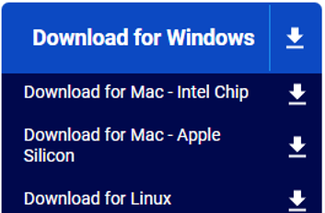
Software Prerequisites for Serving App
Docker Desktop
Including Docker Engine, Docker CLI, Docker Compose, …
https://www.docker.com/products/docker-desktop/

Slide 6
Software Prerequisites for Serving App
FastAPI
Docker Desktop

Slide 7
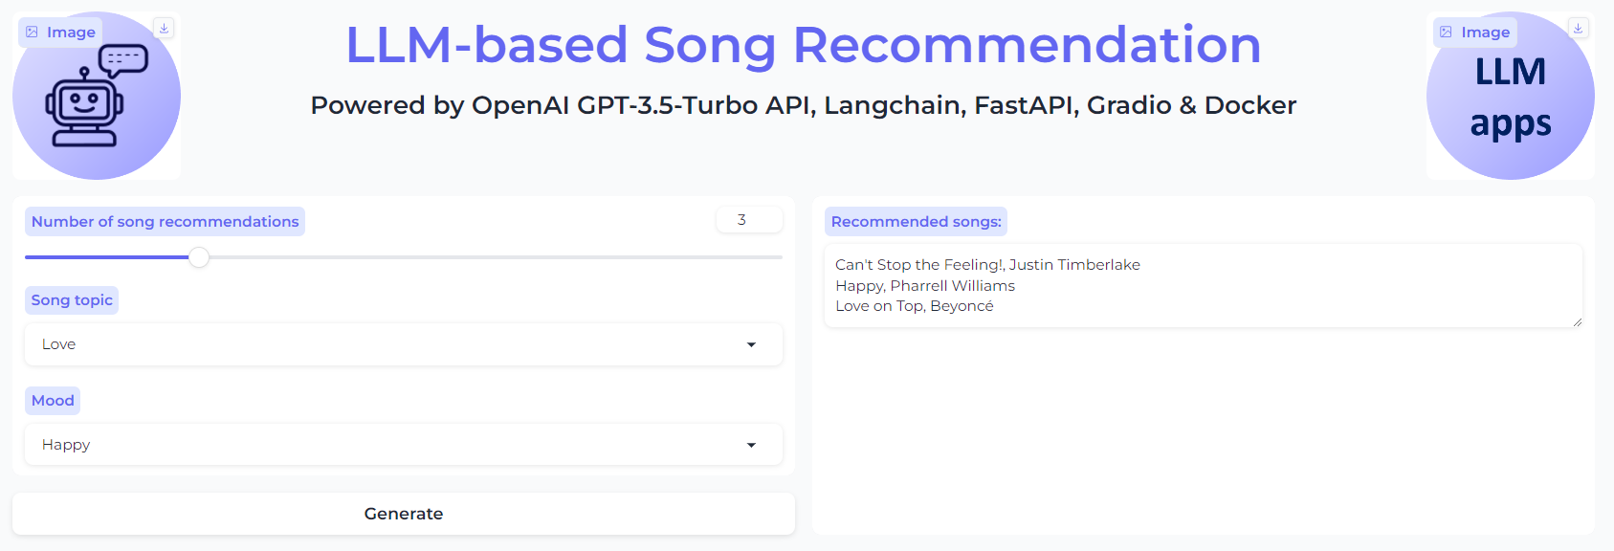
Use-case: Serving LLM-based Song Recommendation App

Slide 8
Source-Code Structure

Slide 9
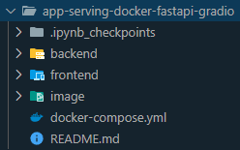
Source-Code Structure

Slide 10
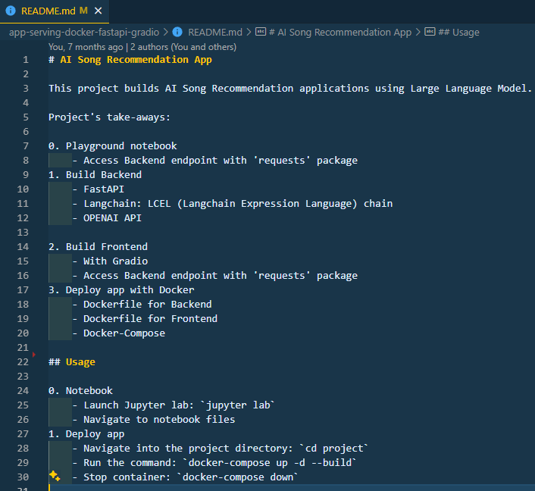
README

Slide 11
docker-compose.yml
version: '3'
services:
backend:
restart: always
build: ./backend
ports:
- '8000:8000'
volumes:
- ./backend:/app
frontend:
restart: always
build: ./frontend
ports:
- '7860:7860'
volumes:
- ./frontend:/app

Slide 12
Backend Source-Code

Slide 13
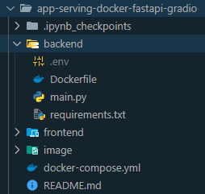
Backend Source-Code

Slide 14
Backend's requirements.txt
# Install packages from PyPI
# For app's backend
python-dotenv==1.0.0
langchain==0.0.345
openai==1.3.7
fastapi==0.104.1
requests==2.31.0
uvicorn==0.24.0

Slide 15
Backend's .env

Slide 16
Backend's main.py

Slide 17
Backend's main.py
import uvicorn
from fastapi import FastAPI
from dotenv import load_dotenv
from langchain.prompts import ChatPromptTemplate
from langchain.chat_models import ChatOpenAI
from langchain.schema import StrOutputParser # Load environment variables
load_dotenv()
# Define the chatbot's prompt template
template = """You are a talented musician.
You recommend a list of the {nb_song} most polular songs and artists about {topic} theme in {mood} mood.
For example, if the song is "I Will Always Love You" by Whitney Houston, return "I Will Always Love You", by Whitney Houston and nothing else.
Return the result as a comma-separated list of song names along with artist name.
"""
app = FastAPI()
@app.get("/song_chain")
async def get_song_chain(no_song: int, topic: str, mood: str):
chat_prompt = ChatPromptTemplate.from_template(template) song_chain = chat_prompt | ChatOpenAI() | StrOutputParser() song_list = song_chain.invoke(
{
"nb_song": no_song,
"topic": topic,
"mood": mood,
}
)
return song_list
if __name__ == "__main__":
uvicorn.run(app, host="localhost", port=8000)

Slide 18
Backend's Dockerfile
FROM python:3.10 WORKDIR /code COPY ./requirements.txt /code/requirements.txt RUN pip install --no-cache-dir --upgrade -r /code/requirements.txt # Set up a new user named "user" with user ID 1000
RUN useradd -m -u 1000 user # Switch to the "user" user
USER user # Set home to the user's home directory
ENV HOME=/home/user \
PATH=/home/user/.local/bin:$PATH # Set the working directory to the user's home directory
WORKDIR $HOME/app # Copy the current directory contents into the container at $HOME/app setting the owner to the user
COPY --chown=user . $HOME/app # CMD ["python", "main.py"]
CMD exec uvicorn main:app --host 0.0.0.0 --port 8000

Slide 19
Frontend Source-Code

Slide 20
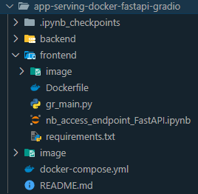
Frontend Source-Code

Slide 21
Frontend's requirements.txt
# For the web app's interface (frontend)
gradio==4.7.1
streamlit==1.29.0
requests==2.31.0

Slide 22
Frontend's main.py
def get_recommended_song(no_song: int, topic: str, mood: str):
try:
response = requests.get(
"http://host.docker.internal:8000/song_chain",
params={"no_song": no_song, "topic": topic, "mood": mood},
)
response.raise_for_status() # Raises a HTTPError if the status is 4xx, 5xx
except (requests.exceptions.RequestException, requests.exceptions.HTTPError) as err:
# Print the error and return None if the request fails
print(f"Error: {err}")
return None
else:
print("Server is running and the endpoint exists.")
return response.json() # Assuming the response is JSON

Slide 23
Frontend's Dockerfile
FROM python:3.10
WORKDIR /code COPY ./requirements.txt /code/requirements.txt RUN pip install --no-cache-dir --upgrade -r /code/requirements.txt # Set up a new user named "user" with user ID 1000
RUN useradd -m -u 1000 user # Switch to the "user" user
USER user # Set home to the user's home directory
ENV HOME=/home/user \
PATH=/home/user/.local/bin:$PATH # Set the working directory to the user's home directory
WORKDIR $HOME/app # Copy the current directory contents into the container at $HOME/app setting the owner to the user
COPY --chown=user . $HOME/app CMD ["python", "gr_main.py"]

Slide 24
Testing RestAPI Communication

Slide 25

Launching Backend Service Locally
Launching Backend service
(aiapp) PS C:\...\app-serving-docker-fastapi-gradio> cd backend
(aiapp) PS C:\...\app-serving-docker-fastapi-gradio\backend> python main.py

Slide 26

Test Backend & Frontend Communication
Playground with Frontend notebook
import requests
def get_recommended_song(no_song: int, topic: str, mood: str):
try:
response = requests.get(
"http://localhost:8000/song_chain",
params={
"no_song": no_song, "topic": topic, "mood": mood
},) # Raise an exception if the status code indicates an error
response.raise_for_status()
except (requests.exceptions.RequestException, requests.exceptions.HTTPError) as err:
print(f"Error: {err}")
return None
else:
print("Server is running and the endpoint exists.")
return response.json() # Assuming the response is JSON
no_song = 3
topic = 'New Year'
mood = 'Happy'
recommended_songs = get_recommended_song(no_song, topic, mood)
print(recommended_songs)
Message from Backend

Slide 27
Launching App with docker-compose

Slide 28
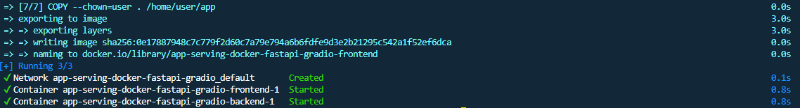
Launching app with docker-compose
(aiapp) PS C:\quangduong\aiapp\app-serving-docker-fastapi-gradio> docker-compose up -d --build

Slide 29
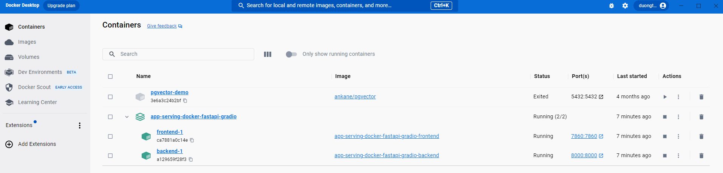
Docker Desktop Interface

Slide 30
Test Backend

Slide 31
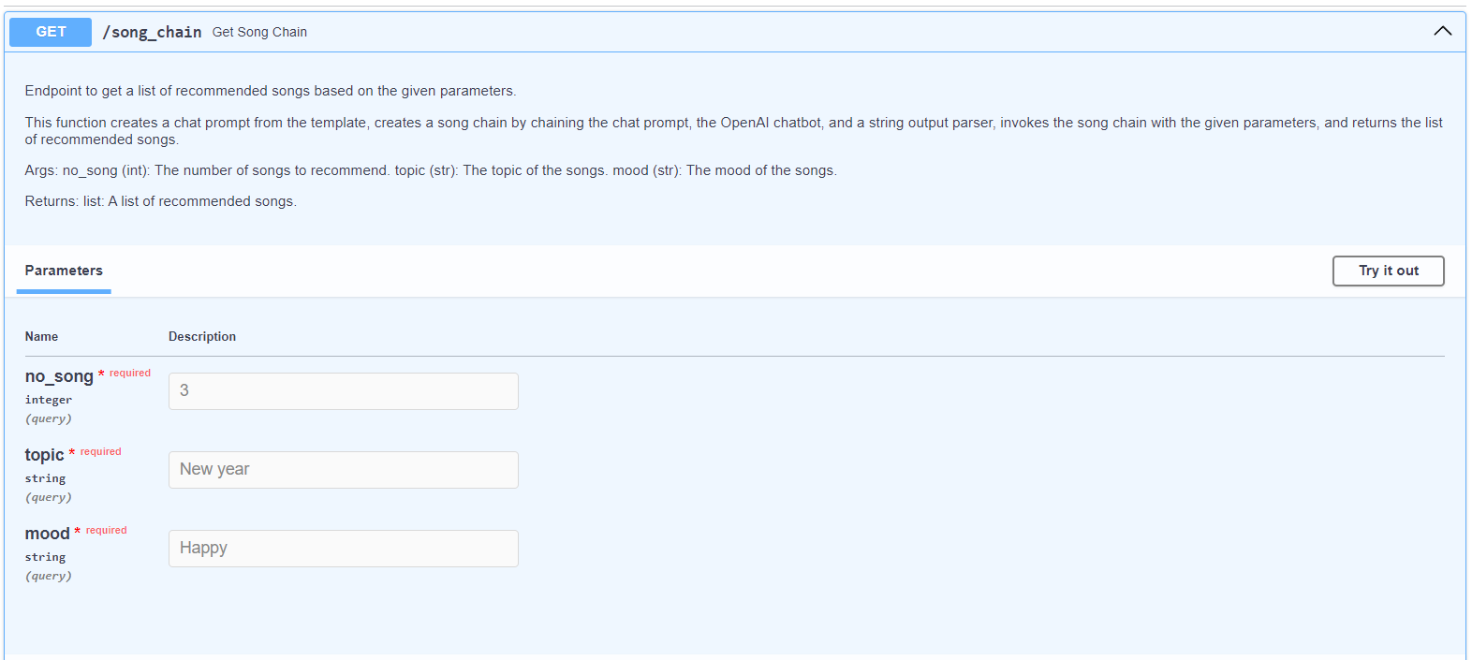
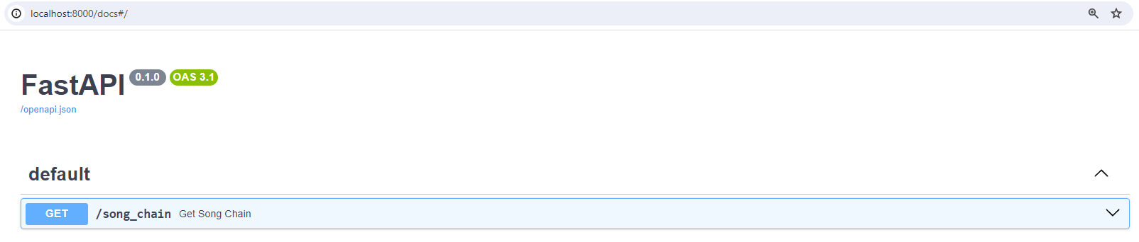
Test Backend
http://localhost:8000/docs/

Slide 32
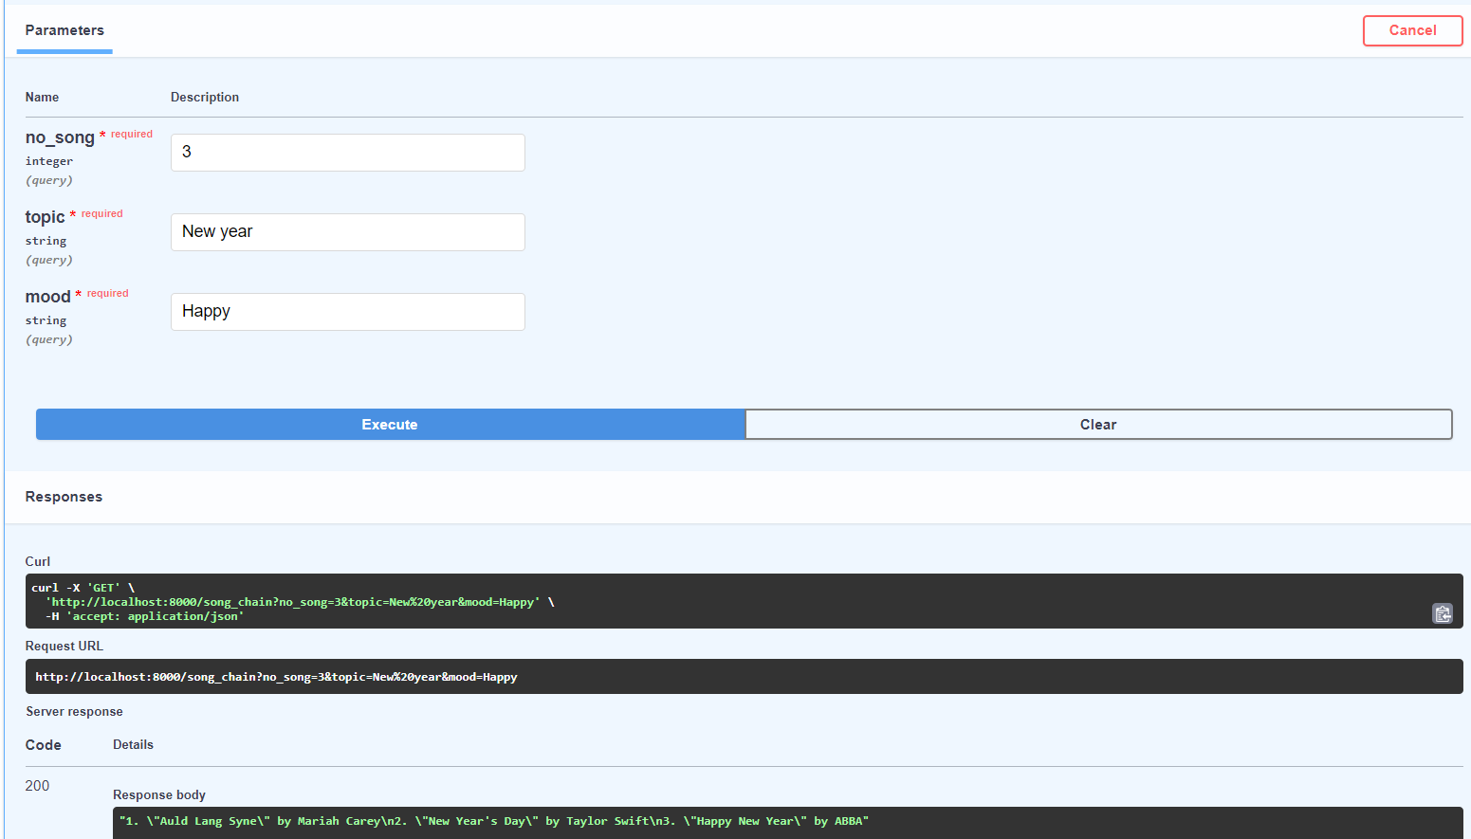
Test Backend

Slide 33
Test Frontend

Slide 34
Test Frontend
http://localhost:7860/

Slide 35
Stopping App with docker-compose
(aiapp) PS C:\quangduong\aiapp\app-serving-docker-fastapi-gradio> docker-compose down

Slide 36
What We Have Learned

Slide 37
In summary
Learned how to serving a demo LLM-based web application
Two separate services
Backend
Python, LangChain, OpenAI API
Frontend
Python, Gradio, Requests
Communication protocol
REST API
FastAPI
Serving app
Docker
Docker Desktop, Dockerfile, Docker-compose

